Slide 1
Automatic Voter Registration & Voter Turnout 2016 & 2020
by Harrison Teeter
Ironhack, Fall 2023

Slide 2
States with AVR

Slide 3


California AVR

Slide 4
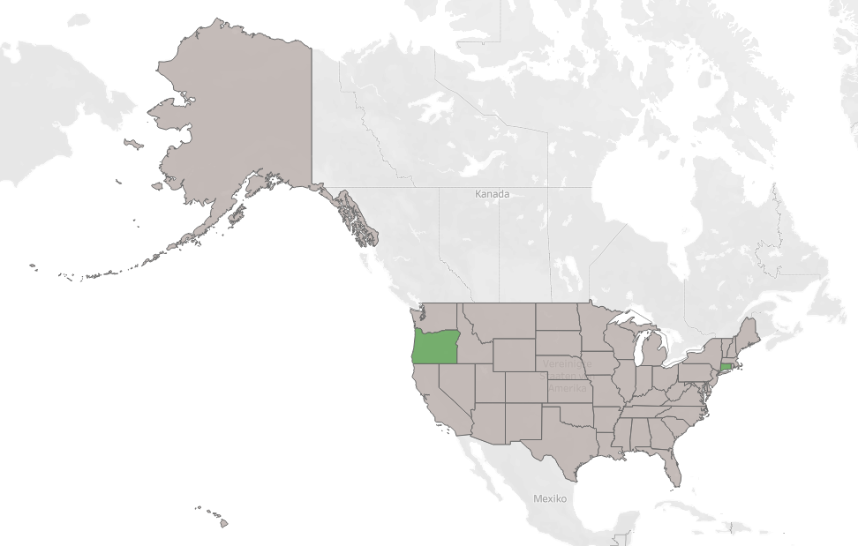
2016

Slide 5
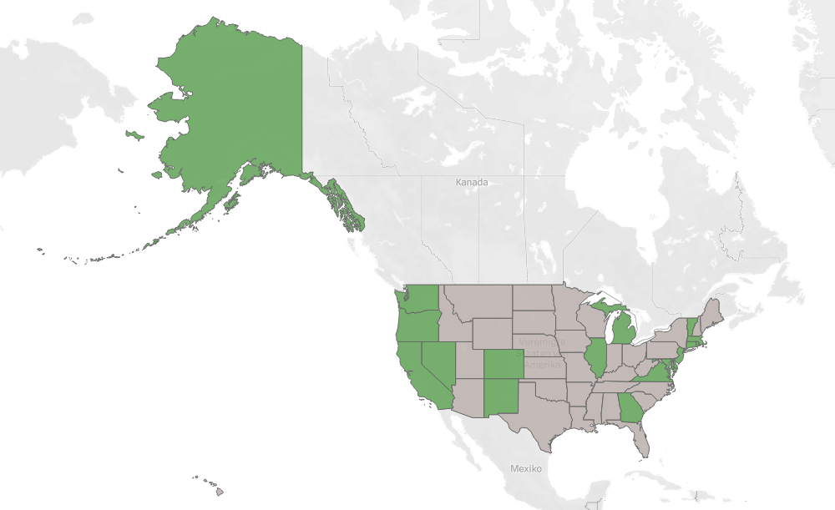
2020

Slide 6
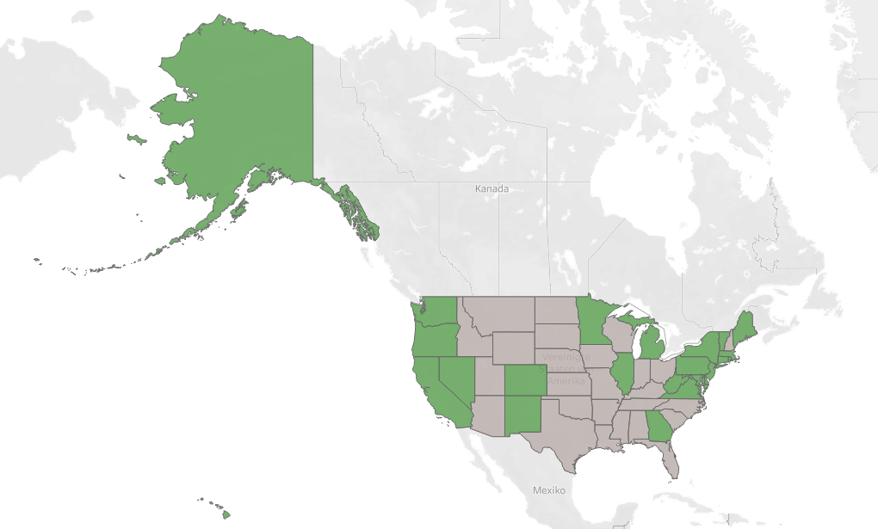
2024

Slide 7
U.S. Presidential Elections

Slide 8
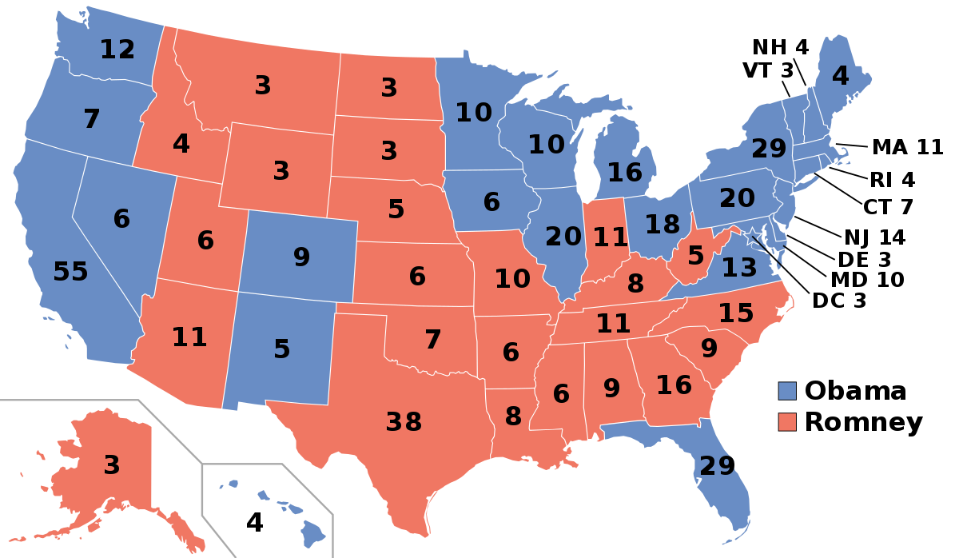
2012

Slide 9
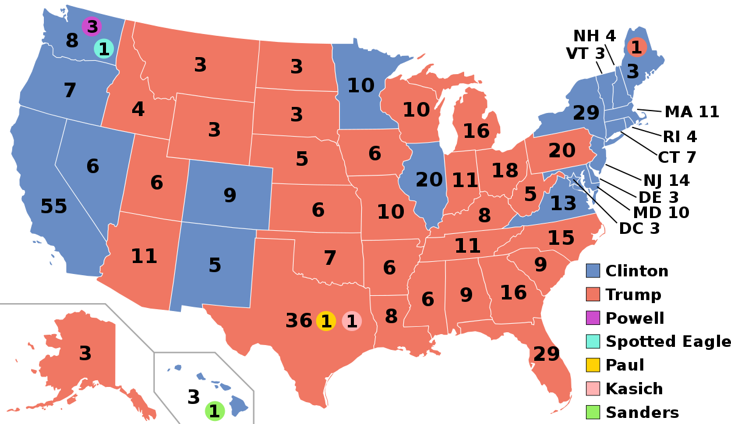
2016

Slide 10
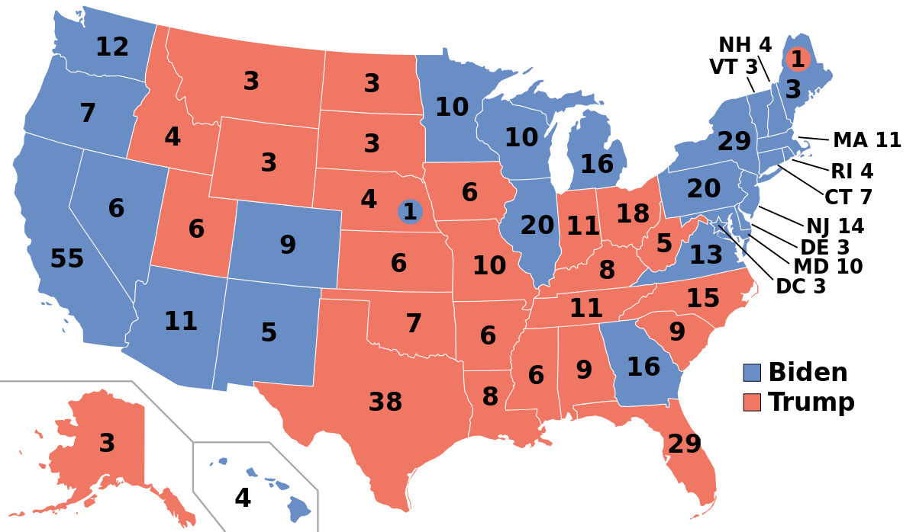
2020

Slide 11
Trend?

Slide 12
2020 2024
Presidential Election Results
States with AVR

Slide 13
Voter Participation Theory

Slide 14
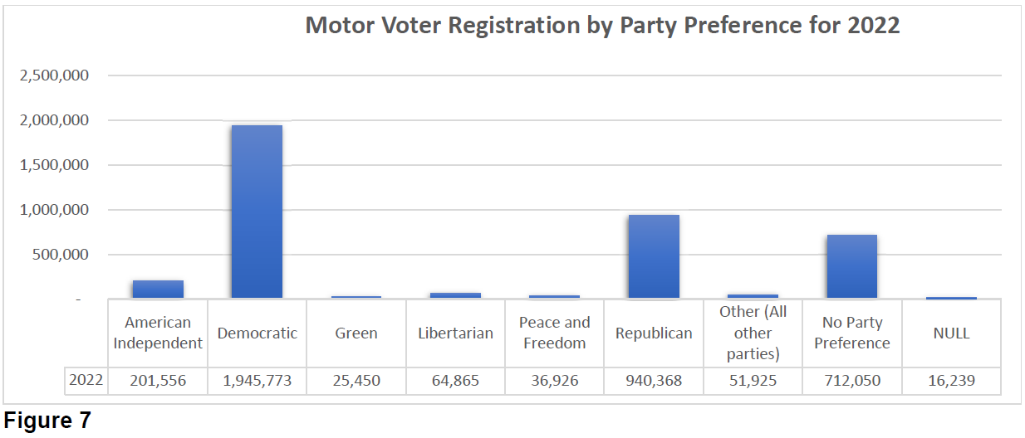
California Registration Statistics

Slide 15
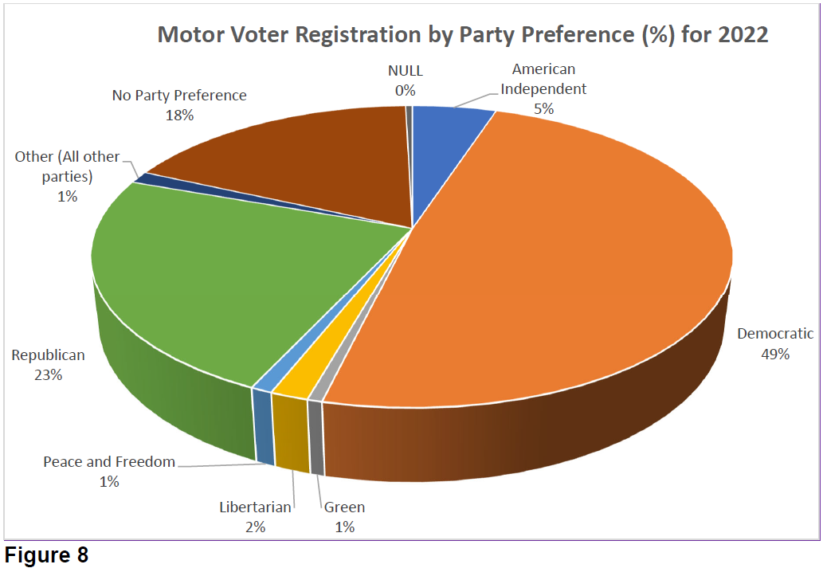

Slide 16
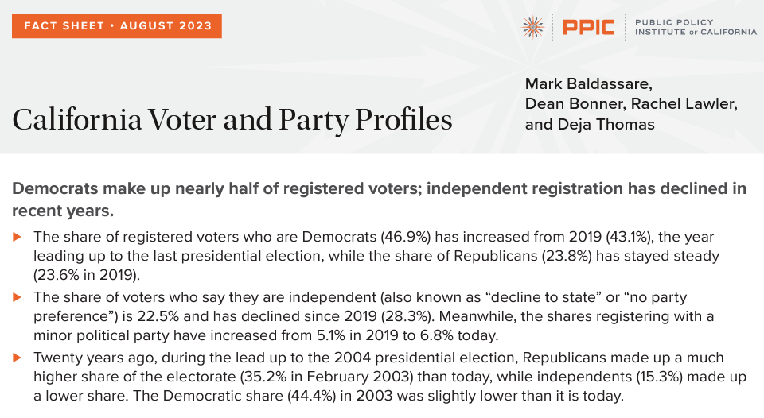

Slide 17
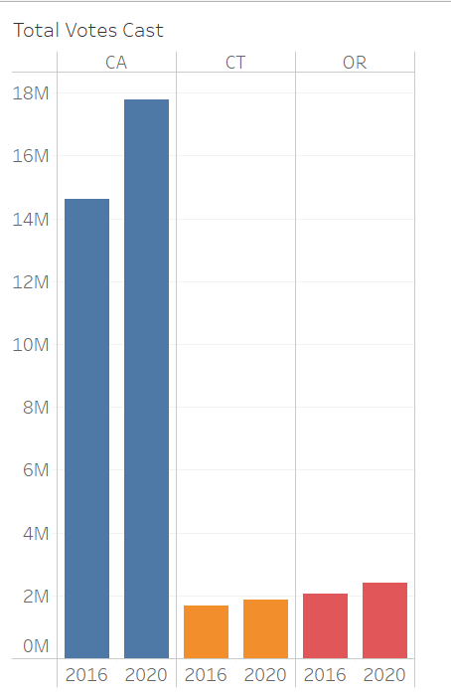
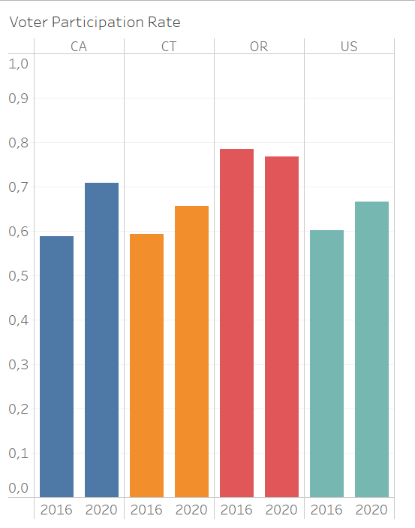
Voter Turnout

Slide 18
Variables
Legal
Non-Legal
Automatic distribution of ballots
Absentee voting availability
Registration deadlines
Early voting availability
Voter ID requirements*
Disqualification from voting
Unsigned absentee ballots
Weather
Motivation
Technical issues
Staffing
Population changes
“Swing state“ status
Spoiled ballot

Slide 19
Sources
The Associated Press
CA Department of Motor Vehicles
CA Secretary of State
CT Secretary of State
National Conference of State Legislatures
OR Secretary of State
Oregon Live - The Oregonian
Public Policy Institute of California
US Elections Project
US Federal Register
US Census Bureau
Wikipedia (presidential election maps)

